Slide 1
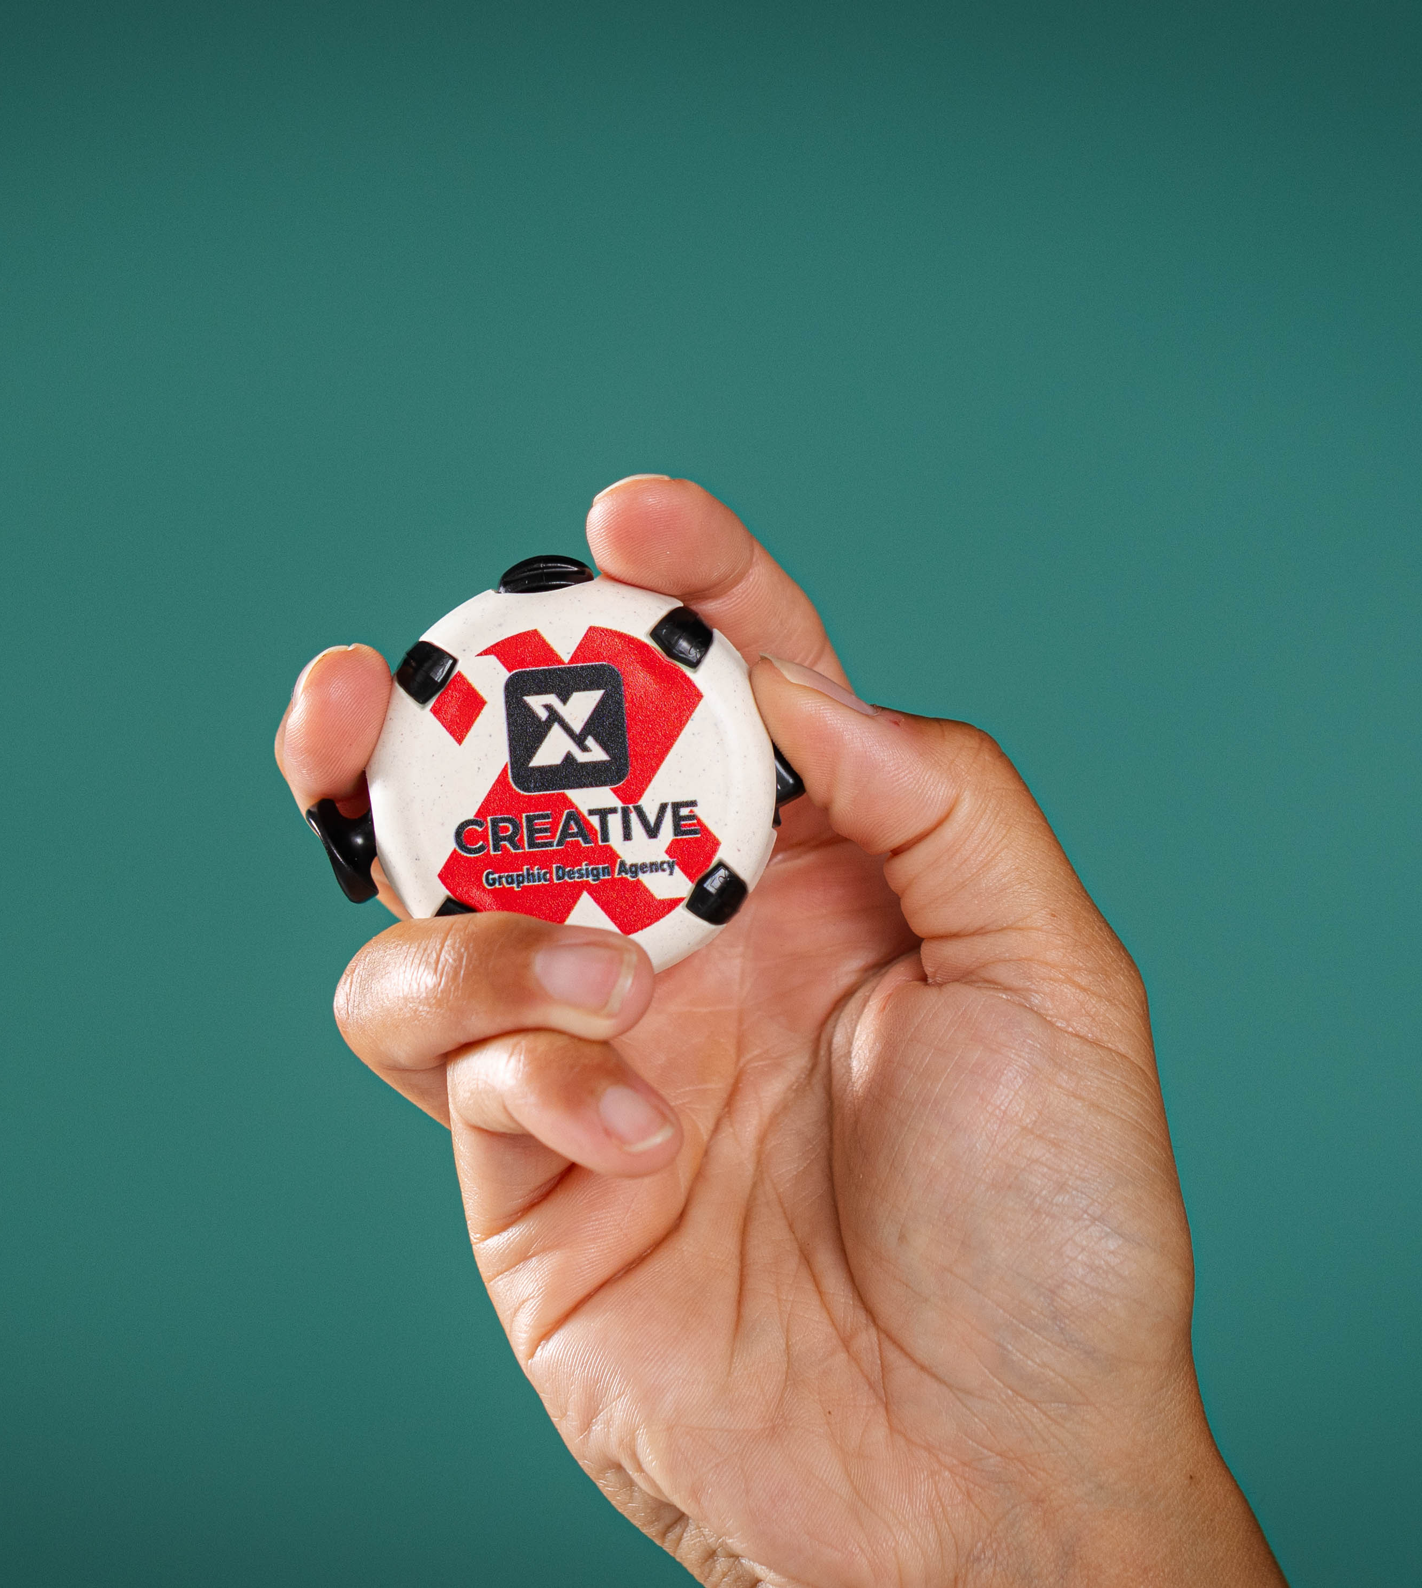
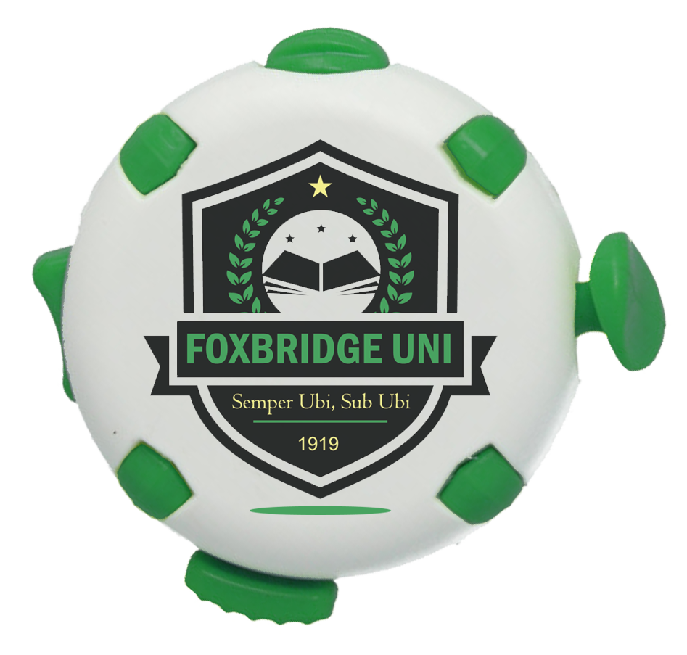
FIDGET PUCK
PRODUCT CODE: FPUCK
UK-MADE | 100% RECYCLED | FAST DISPATCH
The fidget, reinvented. Made for brands.

Slide 2
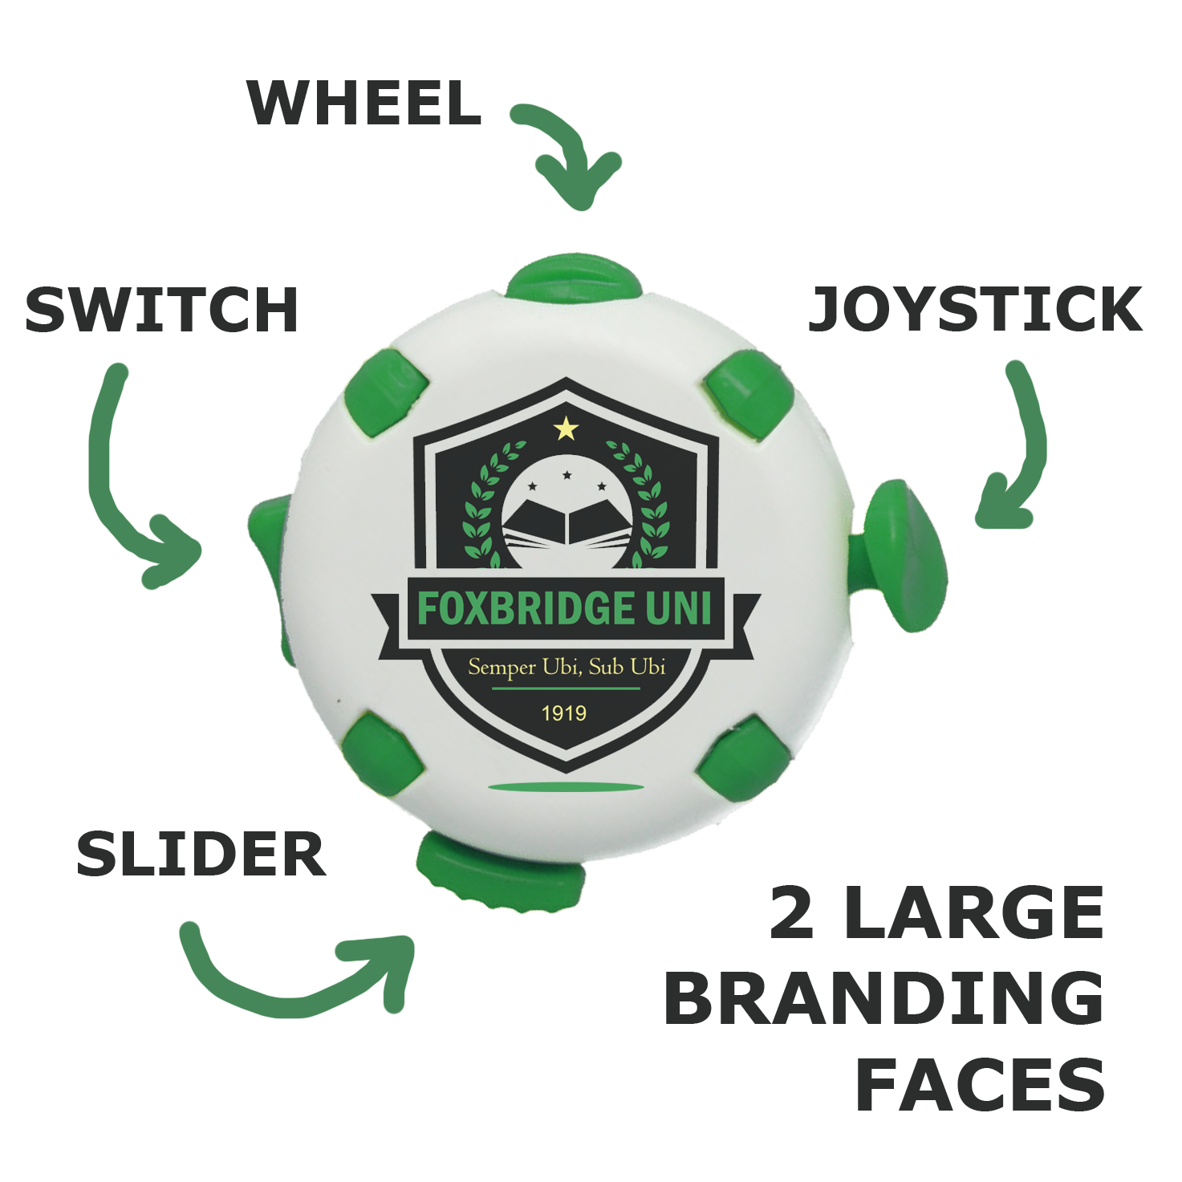

FIDGET PUCK
A premium tactile fidget and focus tool, designed and manufactured in the UK from 100% recycled plastic. Four distinct sensory elements, two large branding faces, and a compact circular form that sits naturally in the hand.
›
Four Fidget Elements
Toggle switch, clicking slider, joystick and spinning wheel - more interaction than any comparable product at this price point.
›
Dual-Face Branding
Both faces are flat, large and print-ready - identical in specification. Far superior to the small, curved or fragmented areas on cubes, spinners and stress balls.
›
Wellbeing & Inclusivity
A practical, branded tool for ADHD, autism, anxiety and sensory processing needs. Recognised in schools, workplaces and universities.
›
UK-Made. Always Recycled.
Manufactured in Cornwall from 100% recycled plastic. R+ recycled biodegradable option available. Solar-powered, zero-waste production.
Note: colour options and print areas are approximate and for illustrative purposes only
DIGITAL FULL COLOUR CMYK PRINT AS STANDARD | WHITE BODY WITH 8 COLOUR OPTIONS FOR FIDGET ELEMENTS AS STANDARD

