Slide 1
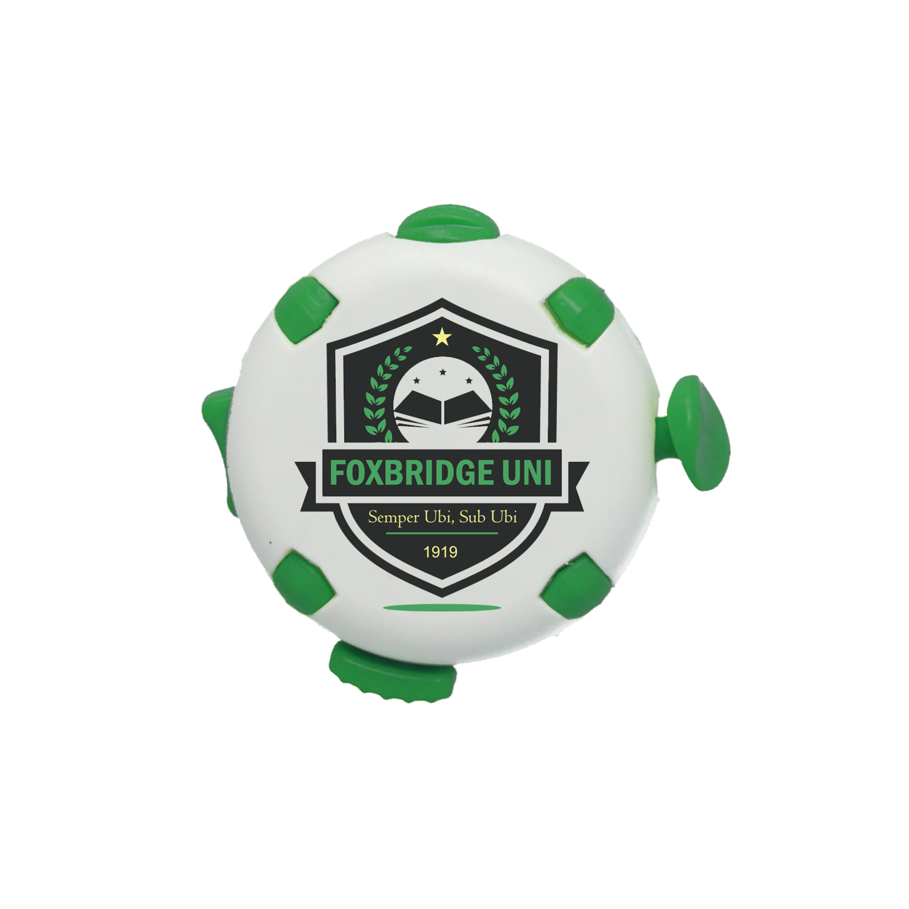
FIDGET PUCK
SALES GUIDE
The fidget reinvented.
Made for brands.
ADD YOUR LOGO & BRAND DETAILS HERE

Slide 2
THE MARKET OPPORTUNITY
Fidget tools are no longer a niche product.
Schools, colleges, employers and healthcare organisations across the UK now recognise fidget tools as practical aids for focus, regulation and wellbeing. Demand for branded versions is growing fast - and until now, the merchandise market has not kept pace.
›
Corporate Wellbeing
›
Education Sector
Employers investing in staff wellbeing and neurodiversity support need branded tools that reflect their values. New starter packs, wellbeing days and desk kits are all strong routes.
Schools, colleges and universities use fidgets as recognised learning aids. End-of-term gifts, fresher packs and classroom resource kits are proven order contexts.
›
Healthcare & Therapy
›
Events & Gifting
OT practices, mental health charities and NHS providers are growing purchasers of branded sensory products. A well-positioned fidget lands differently here than a stress ball.
Trade shows, charity events and corporate hospitality all benefit from a product that recipients actually keep and use. The Fidget Puck has real desk longevity.

Slide 3
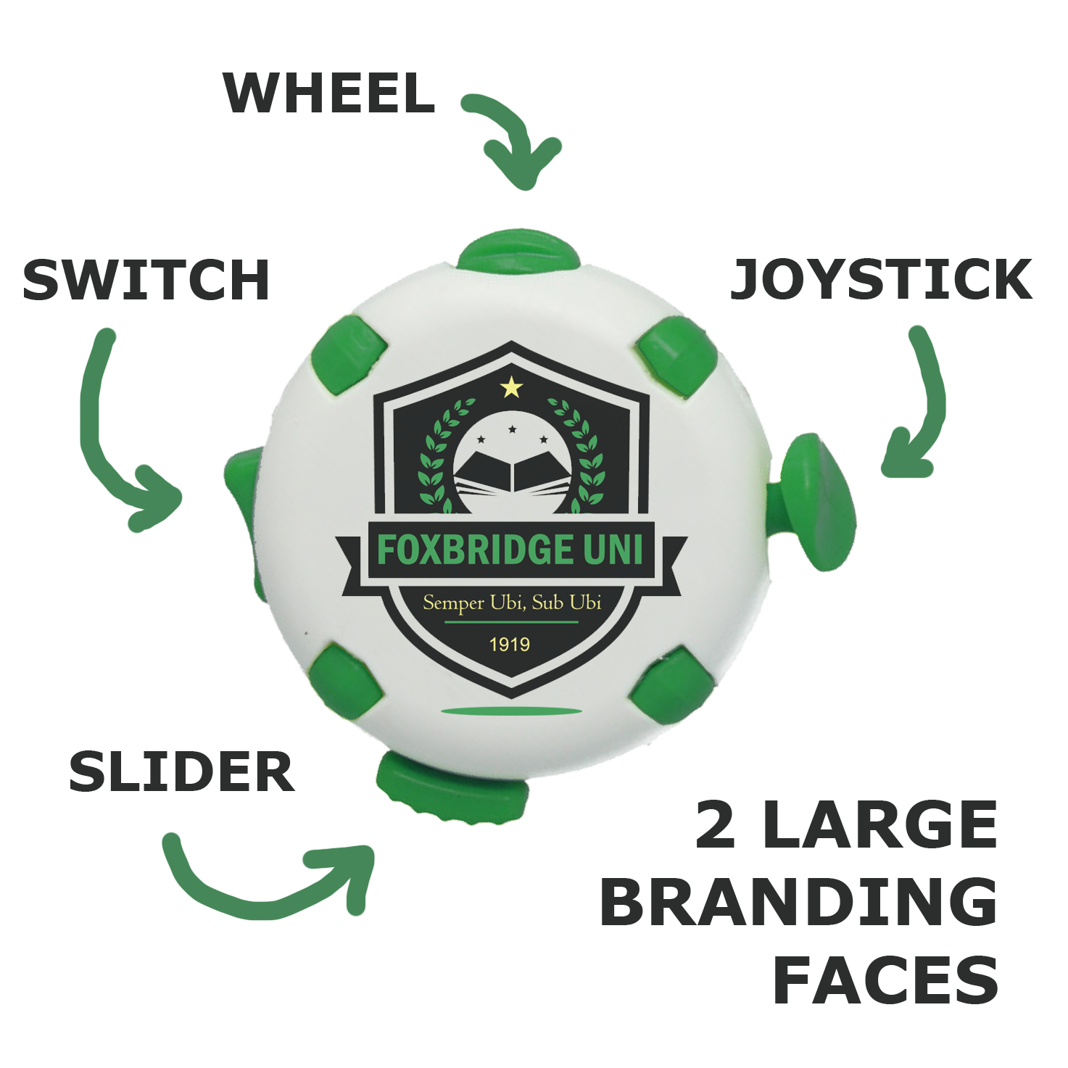
MEET THE FIDGET PUCK
Product Code
FPUCK
Form
Circular, palm-sized
Fidget Elements
4 (switch, slider, joystick, wheel)
Branding Faces
2 large flat faces - both sides identical
Print
Full-colour CMYK digital as standard
Material
100% recycled plastic (R+ available)
Made
UK – zero waste solar powered facility
Dispatch
Fast dispatch, 3-5 days as standard

Slide 4
THE BRANDING ADVANTAGE
Two large, flat, print-ready faces. No curves. No fragmentation. No compromise.
 | Fidget Puck | Fidget Cube | Spinner | Stress Ball
Large flat brand area | ✓ | ✗ | ✗ | ✗
Two branding faces | ✓ | Varies | Varies | Varies
Full-colour CMYK print as standard | ✓ | Additional charge | Additional charge | Additional charge
Multiple fidget elements | ✓ (4) | ✓ (6, smaller) | ✓ (1 motion) | ✗
Pocket-sized & portable | ✓ | ✓ | ✓ | ✓
UK-made, recycled plastic | ✓ | Rarely | Rarely | Rarely
The Fidget Puck's dual flat faces provides a canvas no other fidget product can match.

Slide 5

ALWAYS RECYCLED. ALWAYS UK-MADE.
♻
R+
☀️
100% Recycled Plastic
R+ Available
Solar-Powered Facility
Every Fidget Puck is made from post-consumer recycled plastic as standard. No virgin plastic. No exceptions.
Choose R+ for recycled, recyclable AND biodegradable credentials. Distinctive speckled finish. As white price in R+ ‘Tor’.
Cornish facility runs on solar energy. Production emissions are significantly reduced versus conventional manufacturing.
🗑️
🚫
Made in the UK
Fast Dispatch
Zero-Waste Production
Full traceability. Short supply chain. No long-haul freight. Independently verified UK manufacture.
Fast 3-5 day dispatch as standard, next day dispatch available at additional cost.
All plastic offcuts are recrushed and reused. Nothing goes to landfill from production process.

Slide 6
KEY SELLING POINTS AT A GLANCE
4
2
UK
Fidget elements in one product
Large flat branding faces
Designed and manufactured
More sensory variety than any comparable priced alternative
Print one or both - full-colour CMYK as standard
Cornwall facility - traceable, sustainable, fast
100%
5
£
Recycled plastic as standard
Day standard lead time
No sustainability premium
R+ biodegradable option at the same white price
Next day dispatch available
Recycled UK-made at a competitive price point

Slide 7
COLOUR & MATERIAL OPTIONS
RECYCLED PLASTIC
R+ RECYCLED+
Standard. Proven. Trusted.
Going further. Biodegradable additive included.
Colour options:
R+ colour options (speckled finish):
White
Black
Green
Orange
Tor (white price)
Sky
Buoy
Seaweed
Sand
Made from 100% recycled materials including manufacturing waste
Blue
Red
Yellow
Purple
Biodegradable additive accelerates end-of-life breakdown
White body as standard with any of the above colour fidget elements at white price.
Coloured body available at additional coloured price.
Distinctive natural speckled finish
Tor priced the same as standard white

Slide 8
Ready to order?
Here is how to get started.
1
2
3
4
Confirm Your Requirements
Receive Your Quote
Submit Artwork & Approve
Delivered to You
Quantities, body colour (standard white or R+), element colour preference, and whether you need one or both faces printed.
Clear, competitive pricing with no hidden sustainability surcharge - both material options are priced the same.
Submit your artwork, approve your proof, and confirm the order. Fast turnaround from the UK facility.
Your branded, UK-made, sustainable merchandise - ready to represent your brand with purpose.
ADD YOUR CONTACT DETAILS HERE | [YOUR LOGO] | [YOUR EMAIL / PHONE / WEBSITE]

